Slide 1
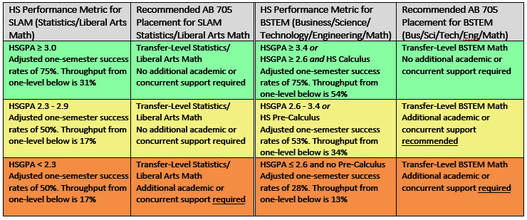
Coastline Math Department Placement Model
SLAM BSTEM
Presented to Academic Senate on May 7, 2019

Slide 2
Required Corequisites Show Improved Success Rates For All Three GPA Bands

